Slide 1
Characterizing and Modeling Non-Volatile Memory Systems
Zixuan Wang,
Xiao Liu, Jian Yang, Theodore Michailidis,
Steven Swanson, Jishen Zhao
Website: cseweb.ucsd.edu/~ziw002/
Code: github.com/TheNetAdmin/LENS-VANS
NVMW 2021

Slide 2
Outline
Background of NVRAM
LENS Profiler
VANS Simulator
Validation Results

Slide 3
NVRAM is Here
Non-Volatile Memory
On memory bus
Byte-addressable
Persistent
We can buy it now
Izraelevitz et al., “Basic Performance Measurements of the Intel Optane DC Persistent Memory Module”, ArXiv 2019.

Slide 4
What’s Wrong?
Izraelevitz et al., “Basic Performance Measurements of the Intel Optane DC Persistent Memory Module”, ArXiV 2019

Slide 5
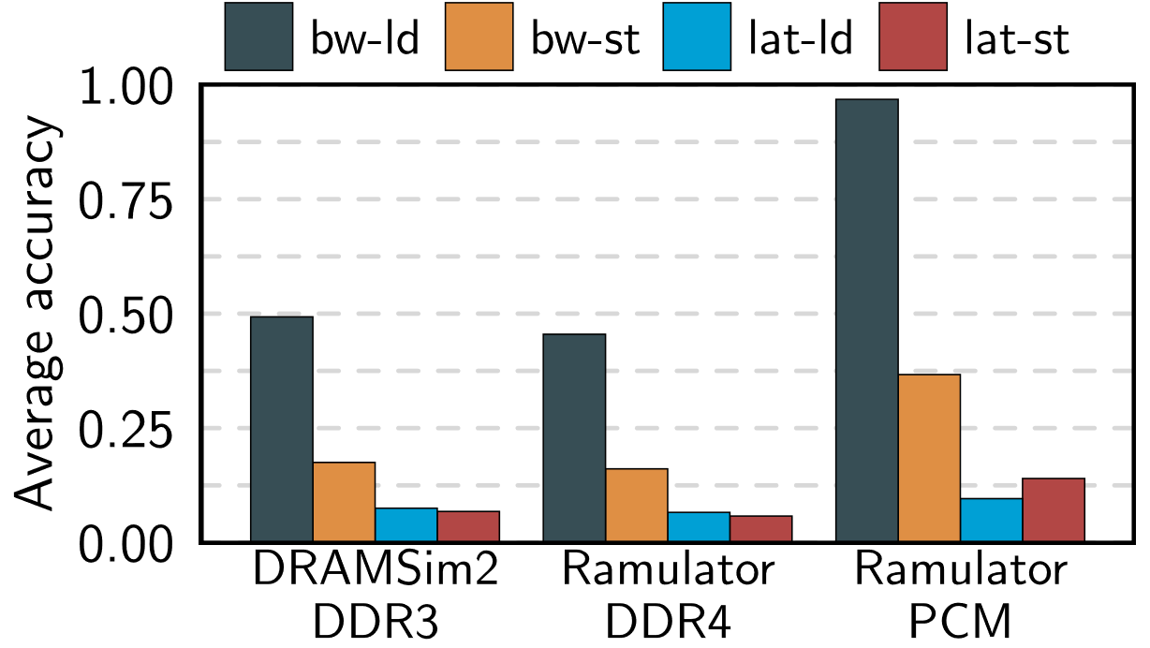
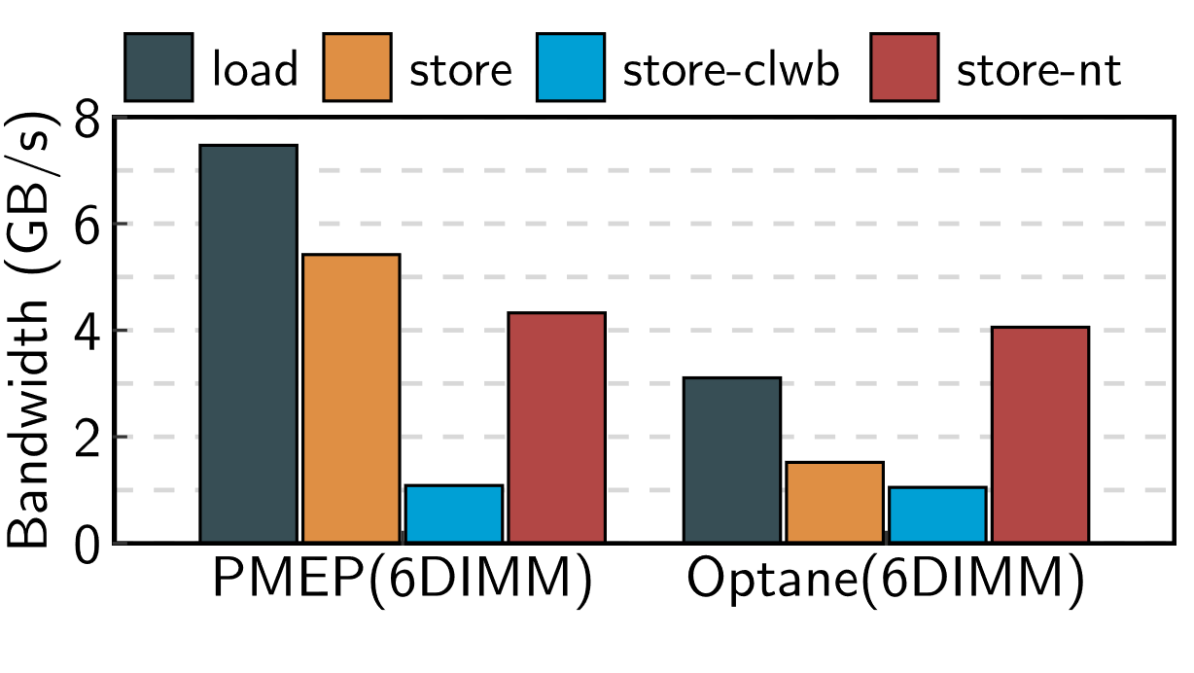
Why Another Simulator?
Understanding Overhead
TLB miss?
Overhead inside DIMM?
Simulators & Emulators
Based on traditional DRAM DIMM architectures
Insufficient accuracy
DRAM
NVRAM
Simulators
Emulators

Slide 6
Why Another Profiler?
NVRAM ≠ Slower DRAM
‘Weird’ performance
Complex controller
Multi-level buffers
DDR-T protocol
Pointer-Chasing Test
NVRAM
DRAM
Need more architecture level details

Slide 7
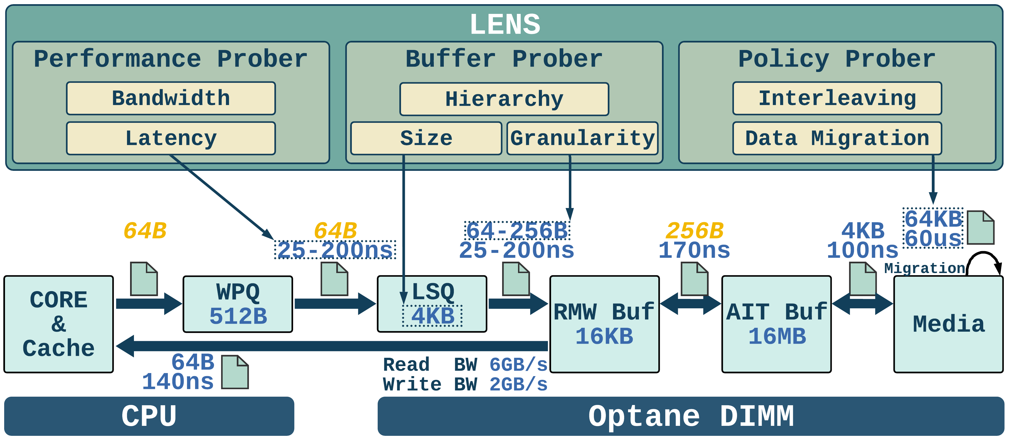
LENS & VANS Overview
LENS: Low-level Profiler for NVM Systems
Customized micro-benchmarks
Profile complex on-DIMM architectures of various NVRAM DIMMs
Low noise
VANS: Validated Architectural NVM Simulator
Validated performance
Verified DDR4 model
General NVM model
Can be attached to gem5
Open Source
github.com/TheNetAdmin/LENS-VANS

Slide 8
LENS & VANS Overview
LENS
Profiles NVRAM
Finds observations
VANS
Takes LENS profiling results
Good to go

Slide 9
Outline
Background of NVRAM
LENS Profiler
VANS Simulator
Validation Results

Slide 10
LENS
LENS Framework
A Linux kernel module
Micro-benchmarks in assembly
Disabled cache prefetching
Non-temporal loads and stores
Use AVX-512 registers (64 byte)

Slide 11
LENS
LENS Framework
Micro-benchmarks for NVRAM
On single-DIMM and multi-DIMM
Access latency
Buffer size
Write policy

Slide 12
LENS – Micro-benchmarks
Pointer-Chasing Test
On-DIMM buffer size
Access granularity
Divide memory region to blocks:
Random access blocks
Sequential access within each block

Slide 13
LENS – Profiling Buffer Structure
Cores
iMC
Pointer-Chasing Access (64B Block)
WPQ
NVRAM
Media
Media
Media
Media

Slide 14
LENS – Profiling Buffer Structure
Cores
iMC
Pointer-Chasing Access (64B Block)
WPQ
NVRAM
512 B
LSQ
4 KB
16KB
16MB
L1 Buf
100 ns
L2 Buf
DRAM
L2 Buf
Media
Media
Media
Media

Slide 15
LENS – Profiling Buffer Entry Size
Cores
Buffer Entry Size
Pointer chasing
Change block size
Measure amplification factor ($Amp$)
$Amp=1$ → $Size\left(Block\right)=Size\left(Entry\right)$
Amplification factor
$$Amp=\frac{Size(Actually Read/Write)}{Size(Requested)}$$
e.g.,
64B read request
→ 256B read into buffer
→ $Amp= \frac{256B}{64B}=4$
iMC
WPQ
NVRAM
LSQ
L1 Buf
L2 Buf
DRAM
Media
Media
Media
Media

Slide 16
LENS – Profiling Buffer Entry Size
Cores
Buffer Entry Size
Pointer chasing
Change block size
Measure amplification factor ($Amp$)
$Amp=1$ → $Size\left(Block\right)=Size\left(Entry\right)$
Example (L1 entry size)
$Size\left(Block\right)=\frac{Size\left(L1 Entry\right)}{2}$
$Amp=\frac{4}{2}$ $=2>1$
iMC
2
0
1
3
WPQ
CPU load 2 entries
NVRAM
L1 Buf load 4 entries
LSQ
L1 Buf
L2 Buf
DRAM
Media
Media
Media
Media

Slide 17
LENS – Profiling Buffer Entry Size
Cores
Buffer Entry Size
Pointer chasing
Change block size
Measure amplification factor
$Size\left(Block\right)=Size\left(Entry\right)$→ $Amp=1$
Example (L1 entry size)
$Size\left(Block\right)=\frac{Size\left(L1 Entry\right)}{2}$
$Amp=\frac{4}{2}$ $=2>1$
$Size\left(Block\right)=Size\left(L1 Entry\right)$
$Amp=\frac{2}{2}=1$
iMC
0
1
WPQ
CPU load 2 entries
NVRAM
L1 Buf load 2 entries
LSQ
L1 Buf
L2 Buf
DRAM
Media
Media
Media
Media

Slide 18
LENS – Profiling Buffer Size
Cores
iMC
Read Amplification
WPQ
NVRAM
LSQ
L1 Buf
256 B
4 KB
L2 Buf
DRAM
Media
Media
Media
Media

Slide 19
LENS – Profiling Buffer Size
Cores
iMC
Write Amplification
WPQ
NVRAM
512 B
LSQ
256 B
L1 Buf
L2 Buf
DRAM
Media
Media
Media
Media

Slide 20
LENS – Profiling Buffer Size
Cores
Size
Entry Size
Functionality
iMC
WPQ
512 B
64 B
Write Queue
NVRAM
LSQ
4 KB
64 B
Write Combining & Request Reordering
L1 Buf
16 KB
256 B
Data Buffer
L2 Buf
DRAM
16 MB
4 KB
Data Buffer
Media
Media
Media
Media

Slide 21
LENS – Profiling Tail Latency
Overwrite Test
Write to the same 256B block
Latency spike every 4MB
Overwrite (256B)

Slide 22
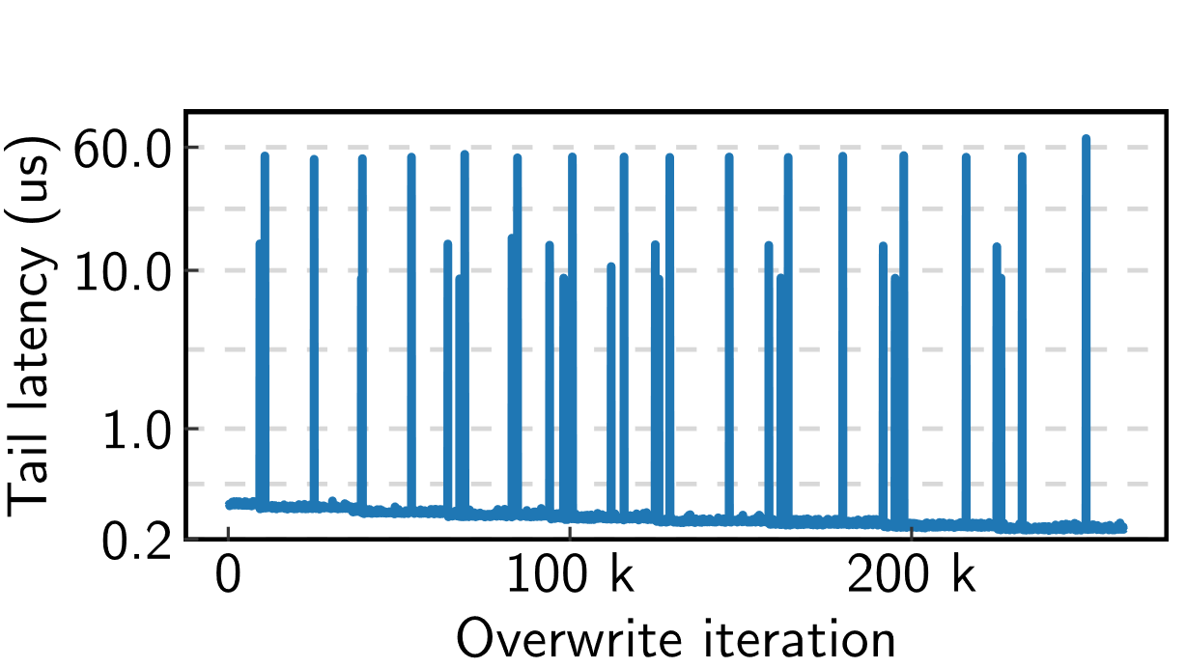
LENS – Profiling Tail Latency
Cores
iMC
Overwrite (256B)
WPQ
NVRAM
LSQ
L1 Buf
L2 Buf
DRAM
Media
Media
Media
Media

Slide 23
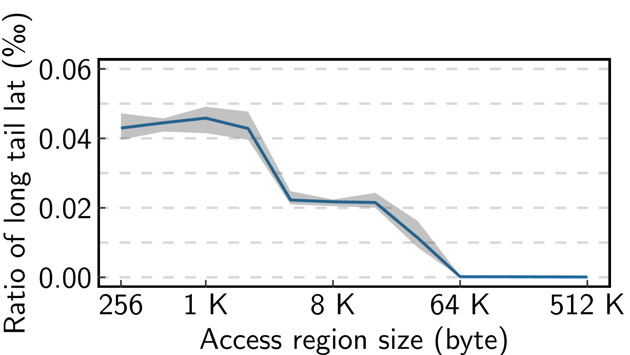
LENS – Profiling Tail Latency
Cores
iMC
Overwrite (Tail Latency Freq.)
WPQ
NVRAM
LSQ
L1 Buf
64 KB
L2 Buf
DRAM
Media
Media
Media
Media

Slide 24
LENS – Profiling Tail Latency
Cores
Data Migration
Wear-leveling / Thermal control
Every 4MB write to a 256B region
64 KB block
iMC
WPQ
NVRAM
LSQ
L1 Buf
L2 Buf
DRAM
Media
Media
Media
Media

Slide 25
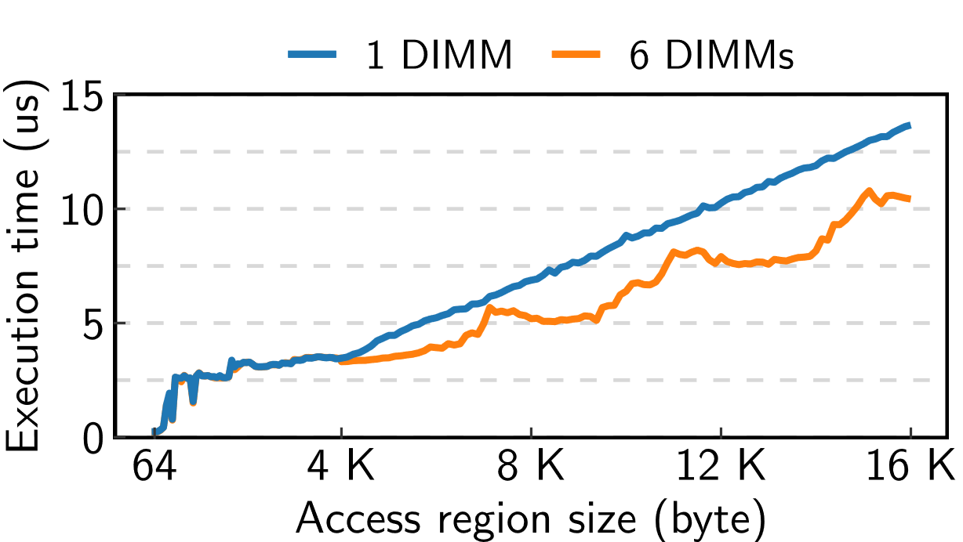
LENS – Multi-DIMM Interleaving Analysis
Interleaving Scheme
Cores
Sequential Write
iMC
WPQ
Page 2
Page 0
Page 1
NVRAM:0
NVRAM:1
NVRAM:2
LSQ
LSQ
LSQ
L1 Buf
L1 Buf
L1 Buf
L2 Buf
DRAM
L2 Buf
DRAM
L2 Buf
DRAM
Media
Media
Media
Media
Media
Media
Media
Media
Media
Media
Media
Media

Slide 26
Outline
Background of NVRAM
LENS Profiler
VANS Simulator
Validation Results

Slide 27
VANS
VANS Framework
Mode
Trace mode
GEM5 mode
Other cycle-level simulators
Components
Easy to customize
Simple config file

Slide 28
VANS
NVRAM DIMM
LSQ
RMW Buffer
AIT Buffer
Media

Slide 29
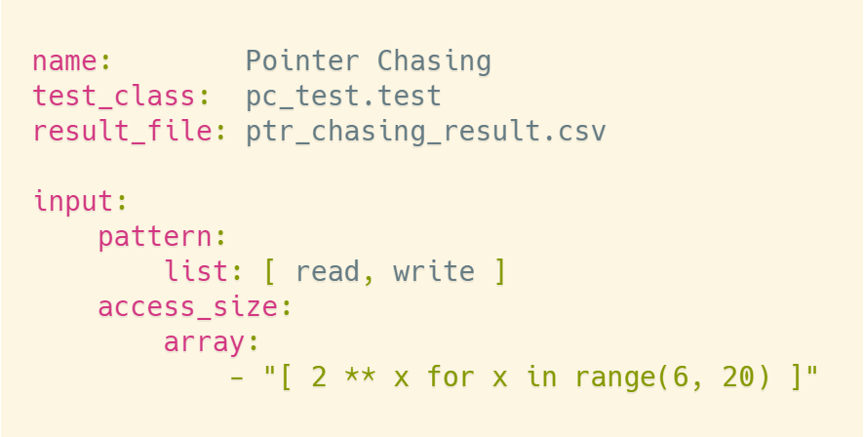
VANS – Testing Framework
Parallel Exec
Result
Parallel Exec
Result
Trace Files
Trace Files
Collect & Visualize
Trace Files
Config File
Generator
Trace Files
Parallel Exec
Result
Parallel Exec
Result

Slide 30
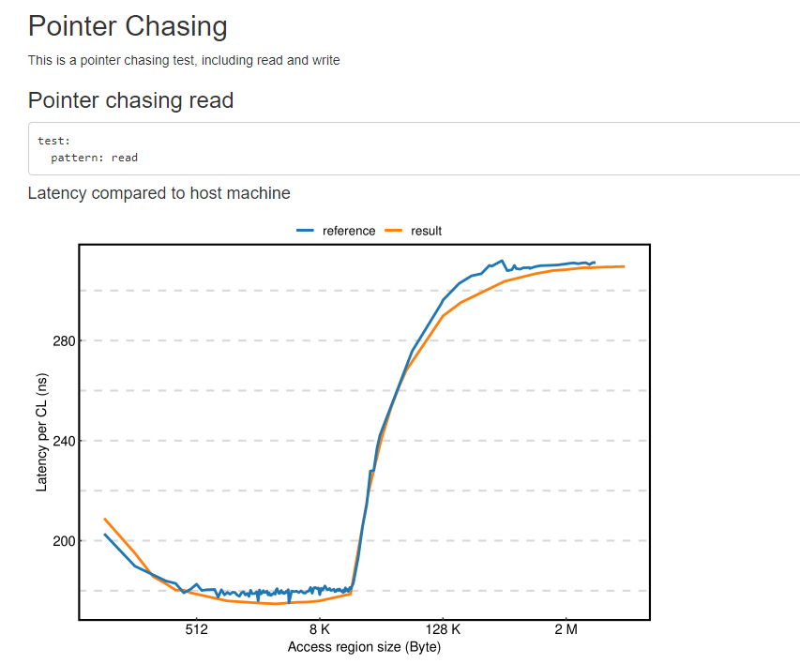
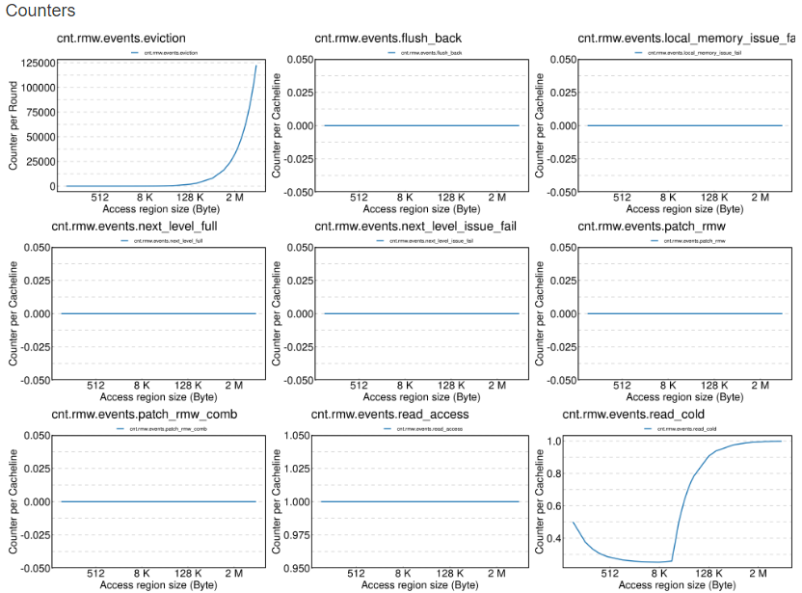
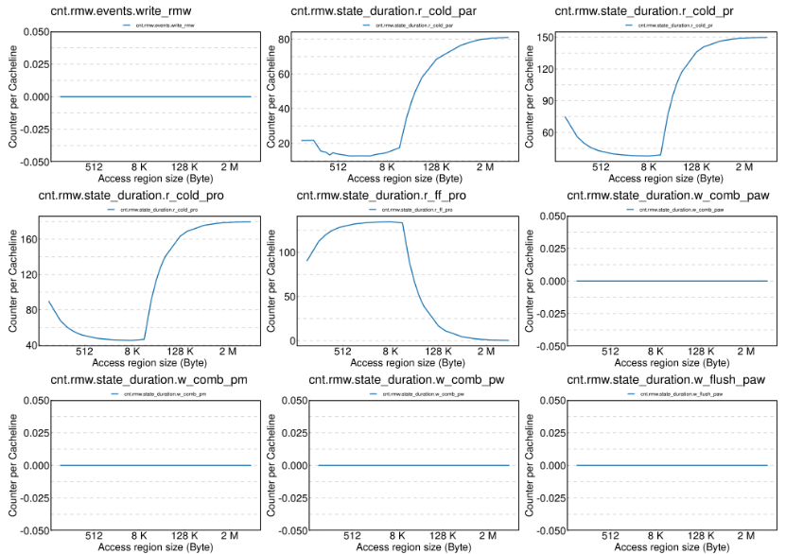
VANS – Testing Framework
Trace Files
Parallel Exec
Result
Collect & Visualize
Trace Files
Trace Files
Config File
Generator
Trace Files
Performance: VANS vs Optane
VANS Internal Counters

Slide 31
VANS – Testing Framework
Trace Files
Parallel Exec
Result
Collect & Visualize
Trace Files
Trace Files
Config File
Generator
Trace Files
With only one line of command:
python3 tests/precision/precision_test.py tests/precision

Slide 32
Outline
Background of NVRAM
LENS Profiler
VANS Simulator
Validation Results

Slide 33
Verification and Validation
DDR4 model verification
Micron DDR4 verification model
Cadence toolchain
NVM model validation
No public formal verification tool
Our approach: Match performance profiling curves
Microbenchmark | Hardware Behavior | Microarchitecture
PtrChasing (64B block) | Buffer overflow | Buffer size
PtrChasing (various block) | R/W amplification | Buffer entry size
Read-after-write | Data fast-forwarding | Buffer hierarchy
Sequential/Strided write | Interleaving speedup | Interleaving scheme
Overwrite (256B region) | Data migration | Migration latency
Overwrite (various region) | Data migration | Migration block size
Strided write | Stable amplification | Internal bandwidth

Slide 34
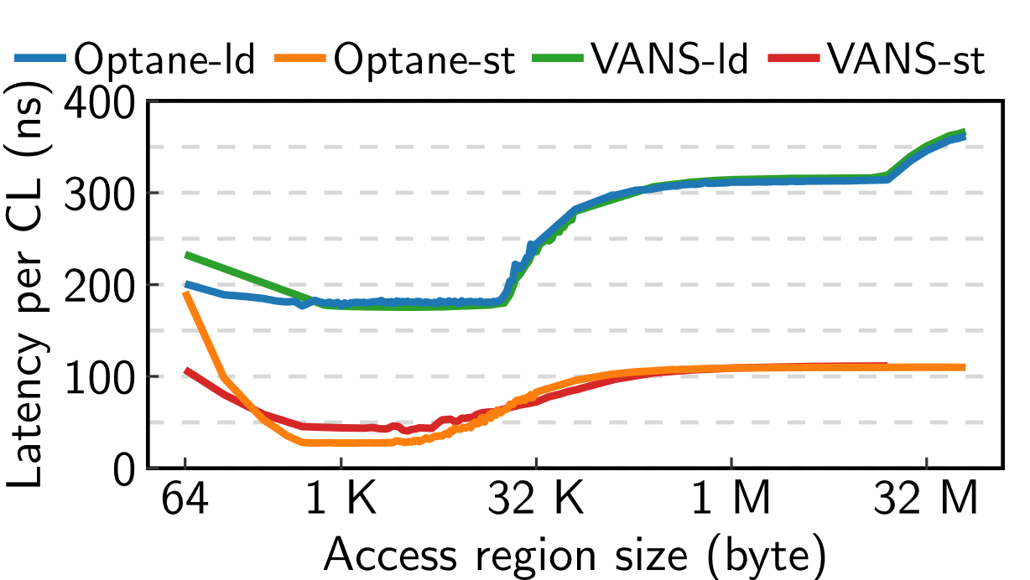
Validation
Pointer Chasing (Single DIMM)
Pointer Chasing (6 DIMM)

Slide 35
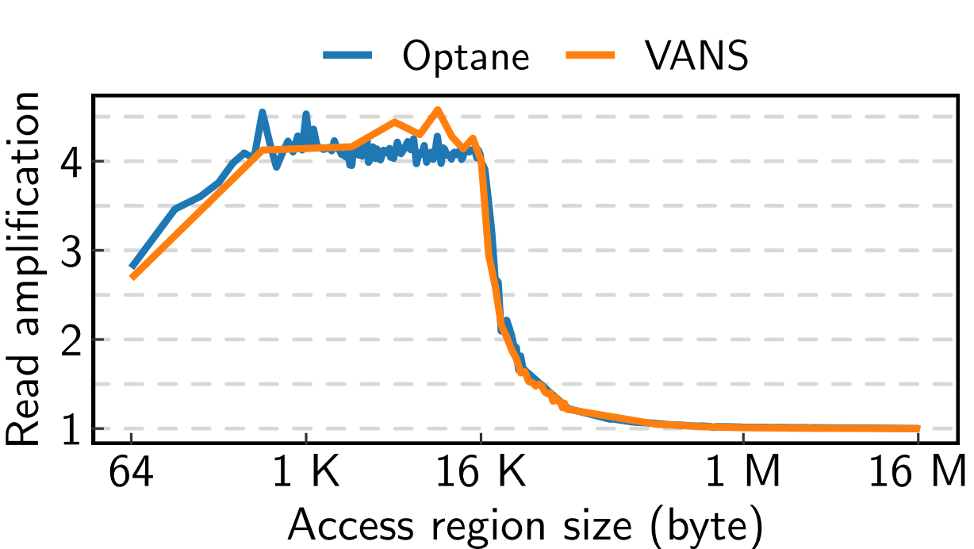
Validation
Read Amplification (HW Counters)
Overwrite (Single DIMM)

Slide 36
Summary
LENS: Low-level Profiler for NVM Systems
Customized micro-benchmarks
Profile complex on-DIMM architectures of various NVRAM DIMMs
Low noise
VANS: Validated Architectural NVM Simulator
Validated performance
Verified DDR4 model
General NVM model
Can be attached to gem5
Open Source
github.com/TheNetAdmin/LENS-VANS

Slide 37
Characterizing and Modeling Non-Volatile Memory Systems
Zixuan Wang,
Xiao Liu, Jian Yang, Theodore Michailidis,
Steven Swanson, Jishen Zhao
Website: cseweb.ucsd.edu/~ziw002/
Code: github.com/TheNetAdmin/LENS-VANS
This presentation and recording belong to the authors.
No distribution is allowed without the authors' permission.
NVMW 2021

